Slide 1
Introduction to openIMIS Module 4: Sustainability and the role of the openIMIS community
Presented by
openIMIS Initiative
Inputs by
Konstanze Lang (GIZ), Daniella Majakari (Swiss TPH)

Slide 2
Overview
Learning objectives:
Discover how the openIMIS Community can support new implementation teams and how learning from local implementations benefit the global product and community
Appraise the value of being par of the openIMIS community
Duration: approx. 30min
Module 4
Notes:
As mentioned before, the learning objective of this particular module is to firstly understand key terms linked to health systems and health financing. You will also be able to explain the functionalities of openIMIS but also ist boundaries.
This module will take approximately 50min

Slide 3
Agenda
Digital public goods
Sustainability of openIMIS
The openIMIS Community
Example of events
Module 4

Slide 4



Digital public good in health and social protection

Slide 5
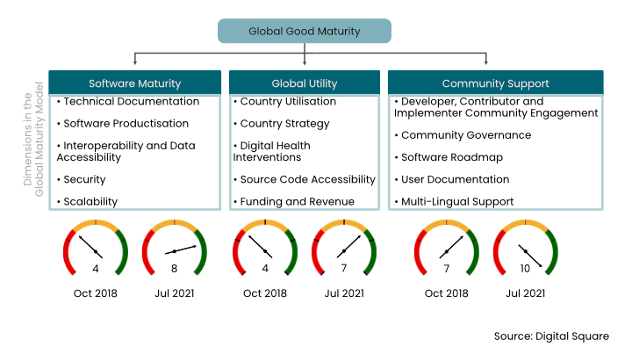

Global good maturity
Notes:
-

Slide 6

Sustainability of openIMIS
Notes:
- ·

Slide 7
Quizz
What is a digital public good? Answer: a digital tool which can be adapted to help address challenges across different countries and context. Wrong: a free software / a health information tool
What are the dimensions of the global good maturity model? Answer: software maturity, global utility, community support. Wrong answers: international data standards, free software, community support / software maturity, global access, capacity building
Module 4

Slide 8
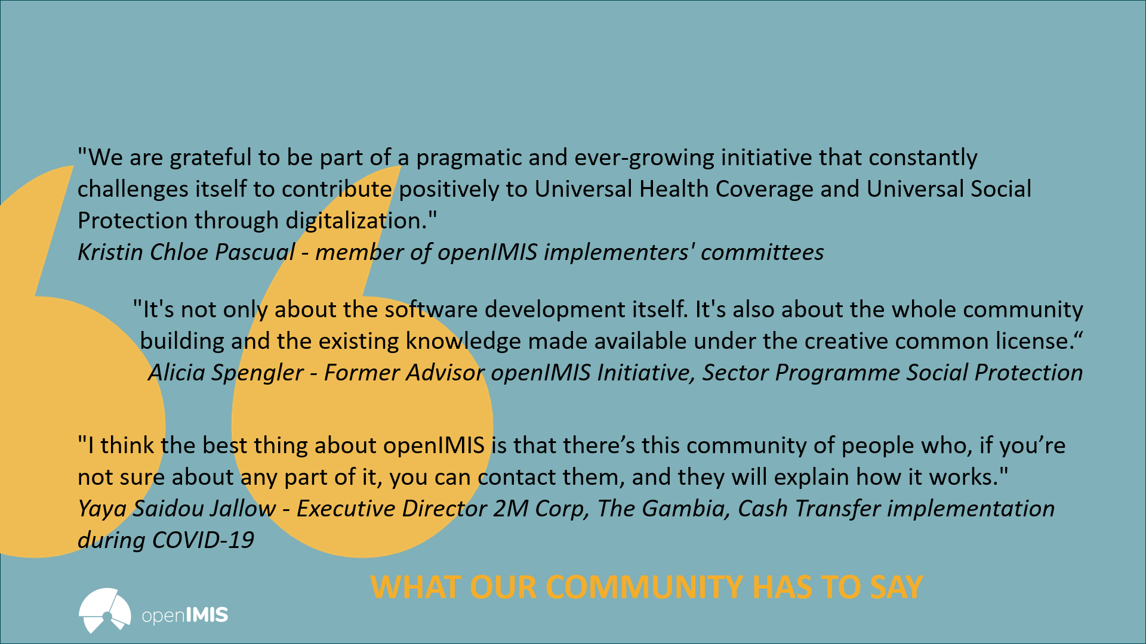
The openIMIS Community

Slide 9

Examples of Events
Examples of events

Slide 10
Further learning resources
Digital Public Goods Alliance: https://digitalpublicgoods.net/
Digital Investment Principles: https://digitalinvestmentprinciples.org/
Global Digital Health Resources and Maturity Models Summary: https://www.healthdatacollaborative.org/fileadmin/uploads/hdc/Documents/Working_Groups/Digital_Health_Interoperability_Working_Group/Global_Digital_Health_Resources_and_Maturity_Models_A_Summary_UPDATED.pdf
AeHIN Webinars on eHealth: https://www.youtube.com/playlist?list=PLN7M3nT7qGnfu329R2YTiuLQV_m4J6vIO

Slide 11
References
Digital Public Goods Alliance (2021) Available from: https://digitalpublicgoods.net/
Digital Investment Principles – The Principles of Donor Alignment for Digital Health (2018) Available from: https://digitalinvestmentprinciples.org/
Global Goods Maturity Model (2021) Available from: https://wiki.digitalsquare.io/index.php/Global_Goods_Maturity
openIMIS (2021) Available from: https://openimis.org/
Module 4

Slide 12






Credits
The development of this e-learning course was supported by:

